Slide 1
expression

Slide 2
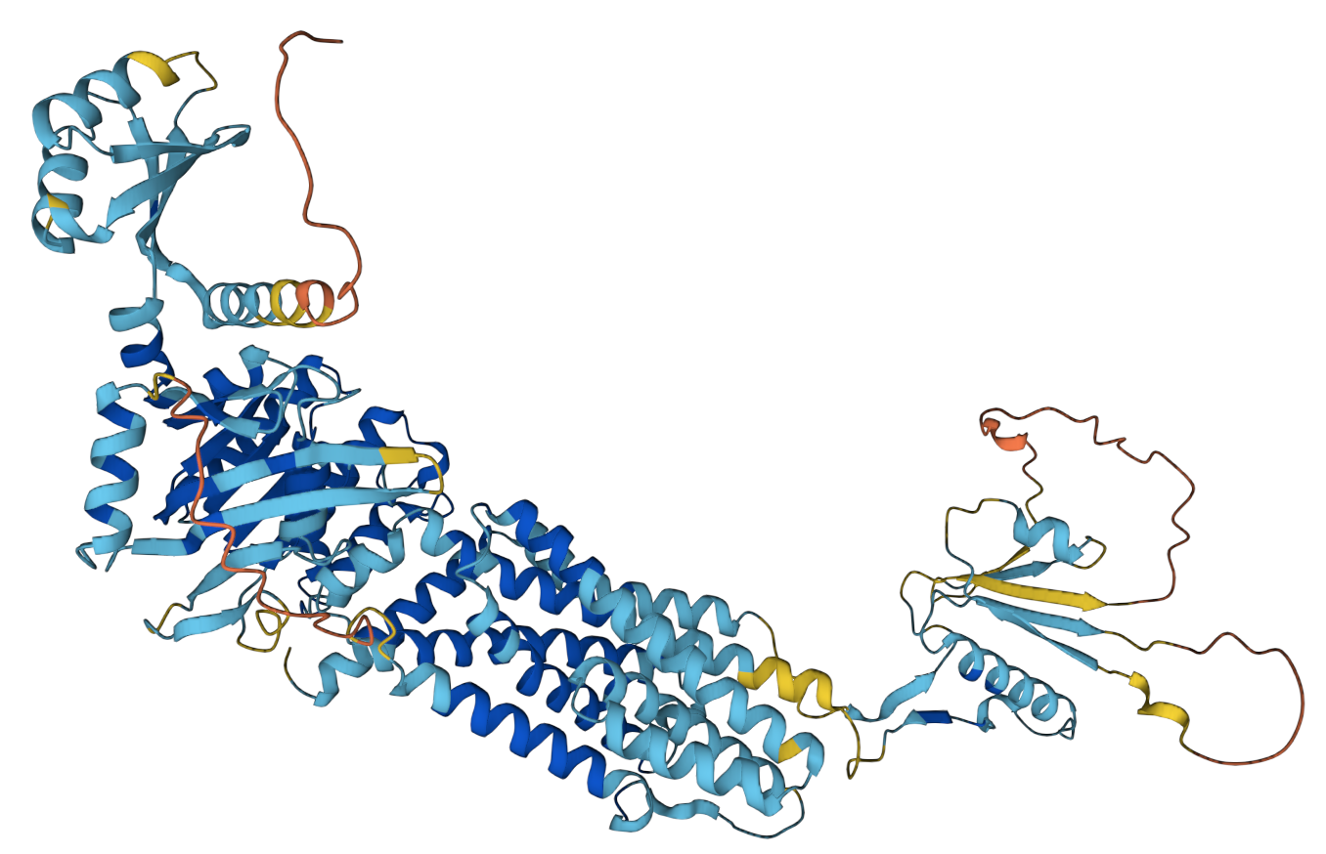
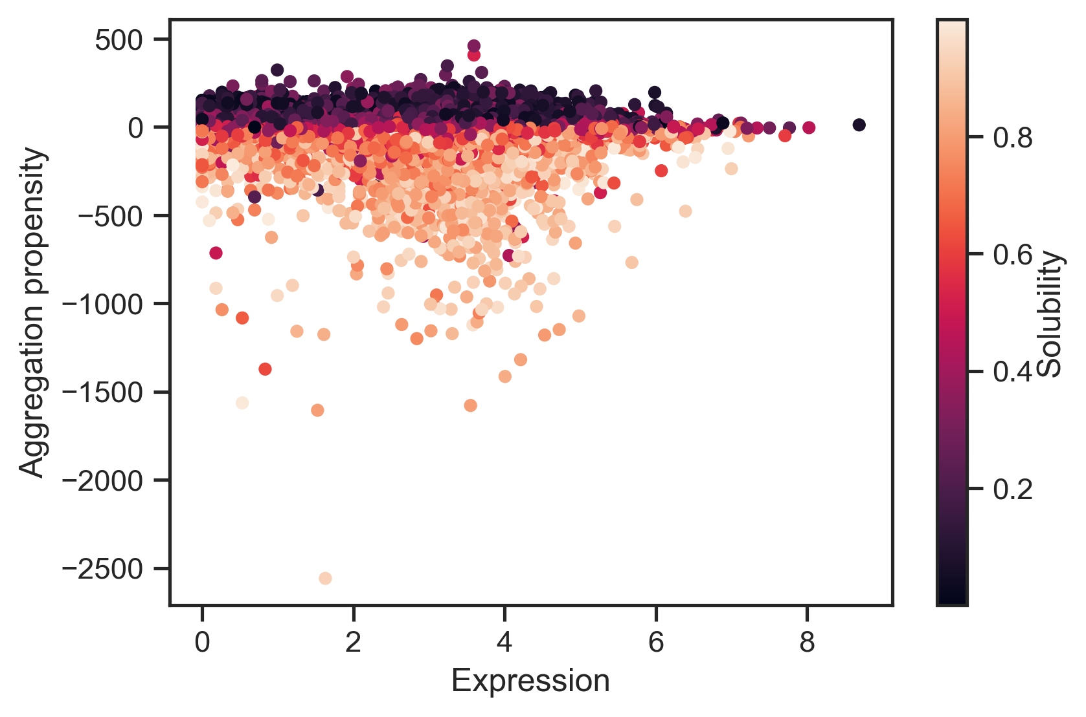
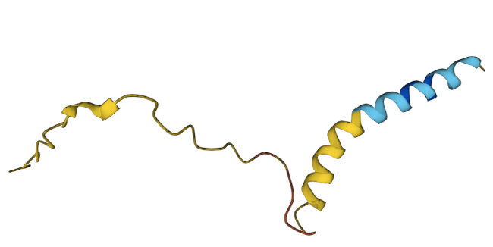
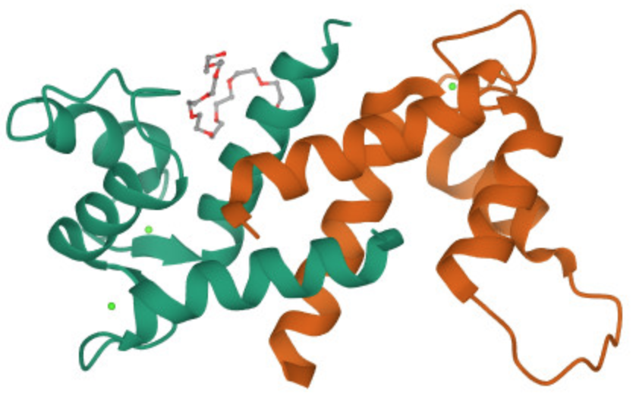
Q86UQ4
P02808
P20930

Slide 3
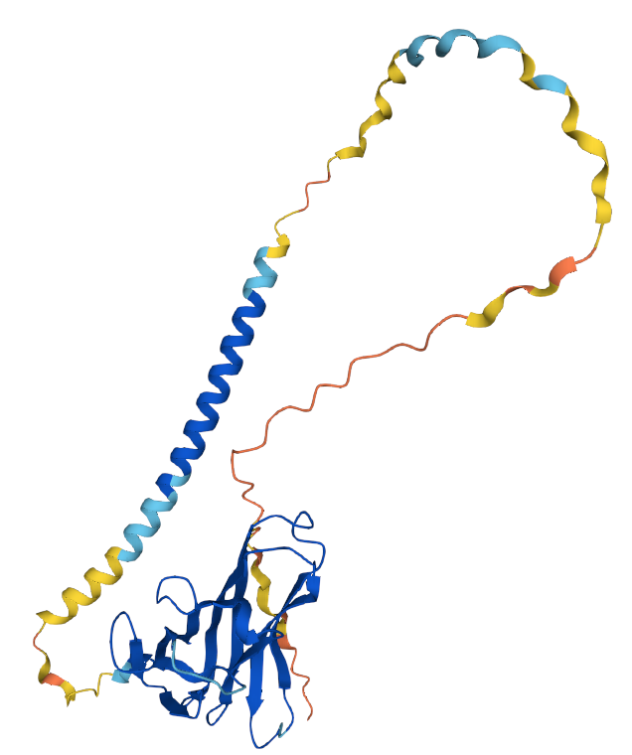
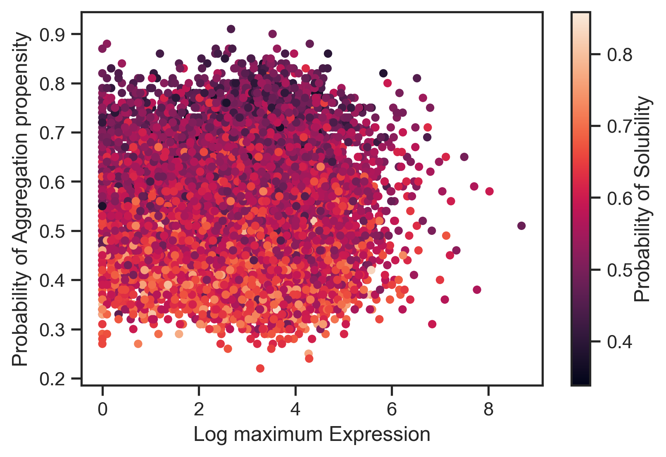
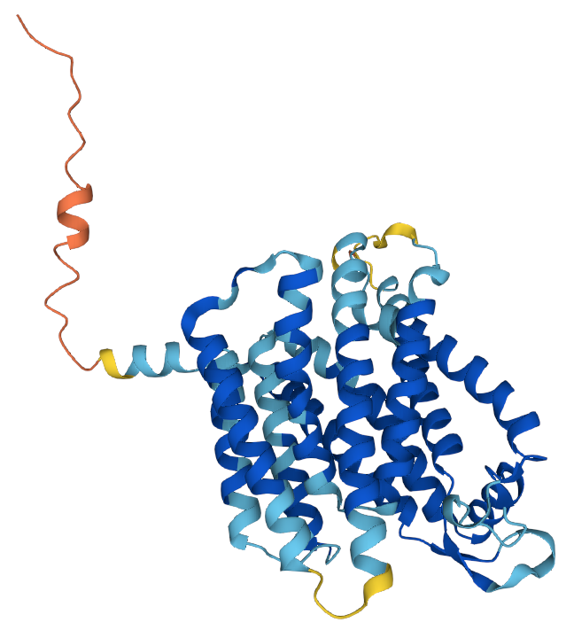
P48023
Tumor necrosis factor ligand superfamily member 6
Tissue: Spleen
P02808
Statherin
Tissue: Salivary gland
Q8N357
Solute carrier family 35 member F6
Tissue: Liver

Slide 4
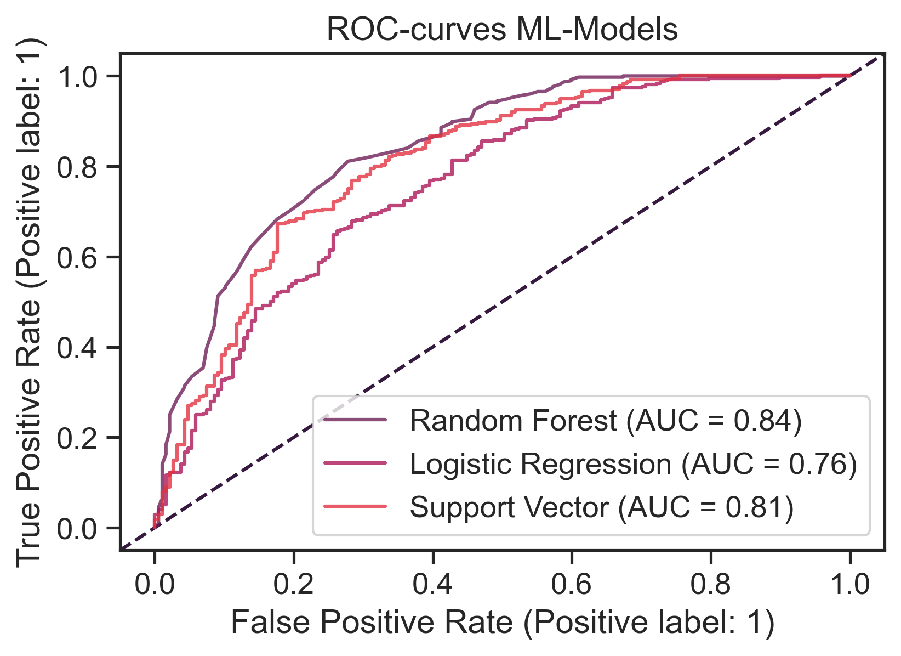
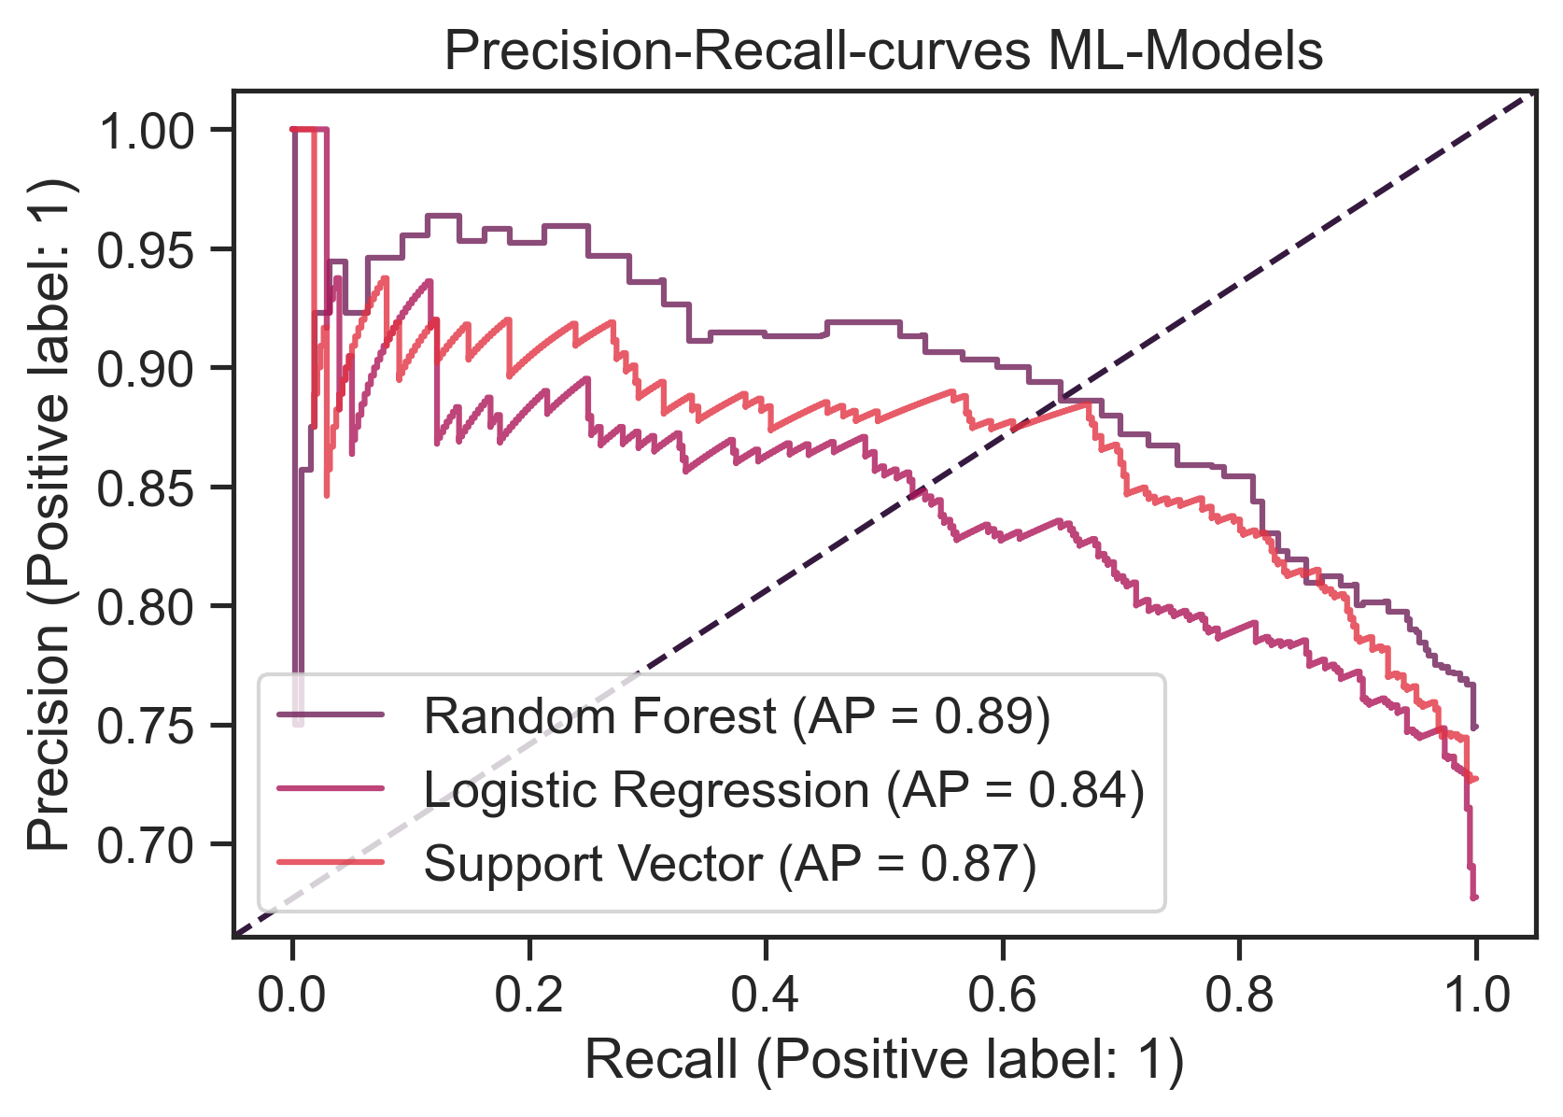
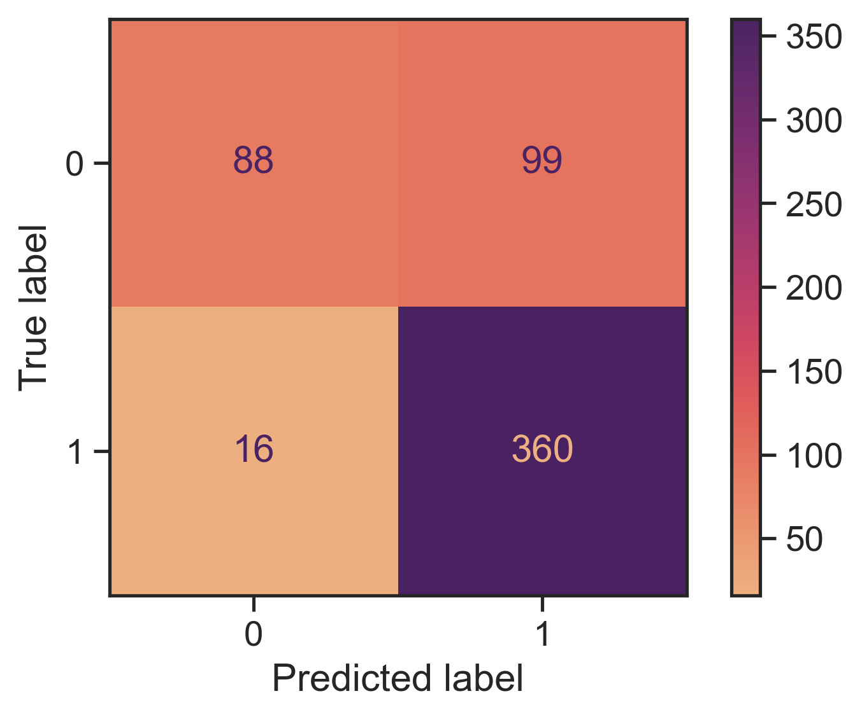
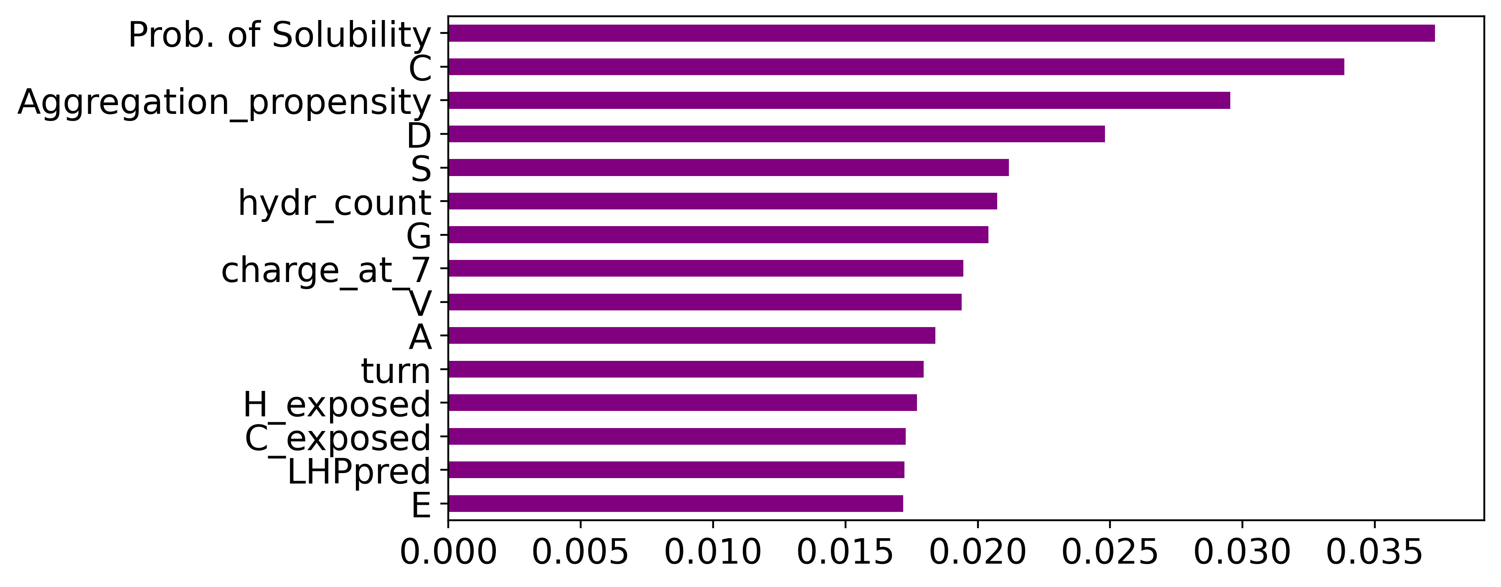
A
B
C
D

Slide 5
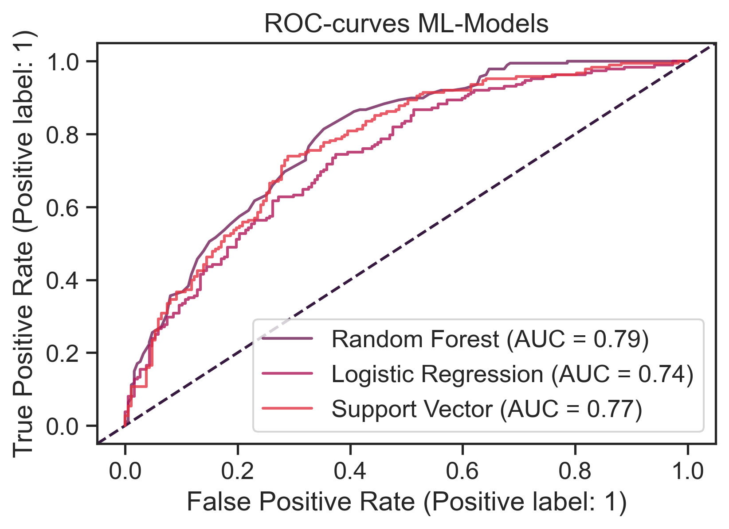
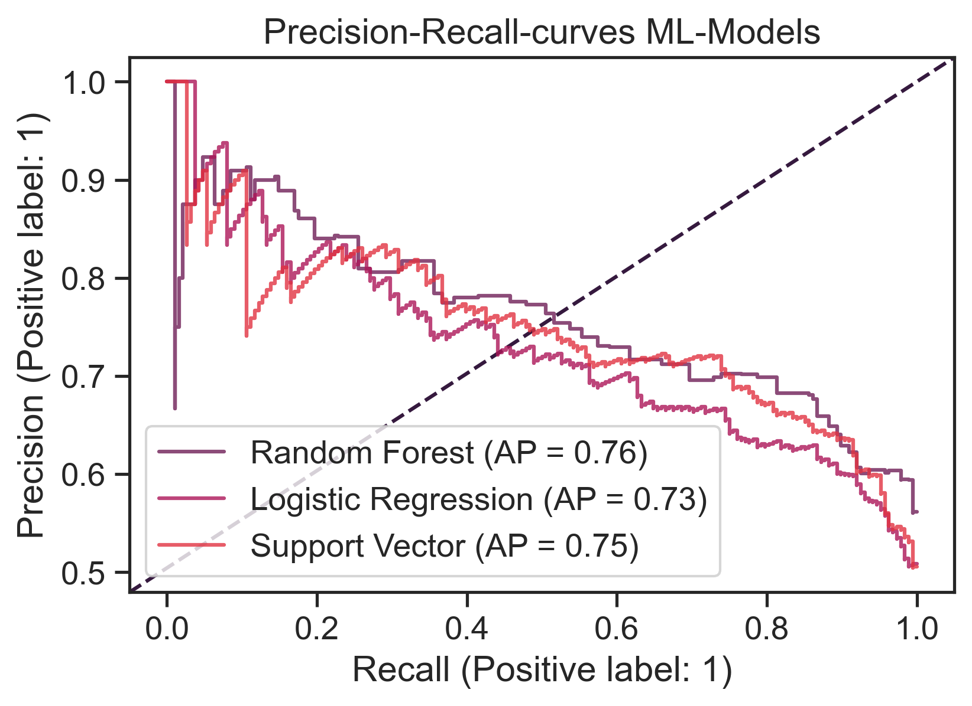
A
B

Slide 6
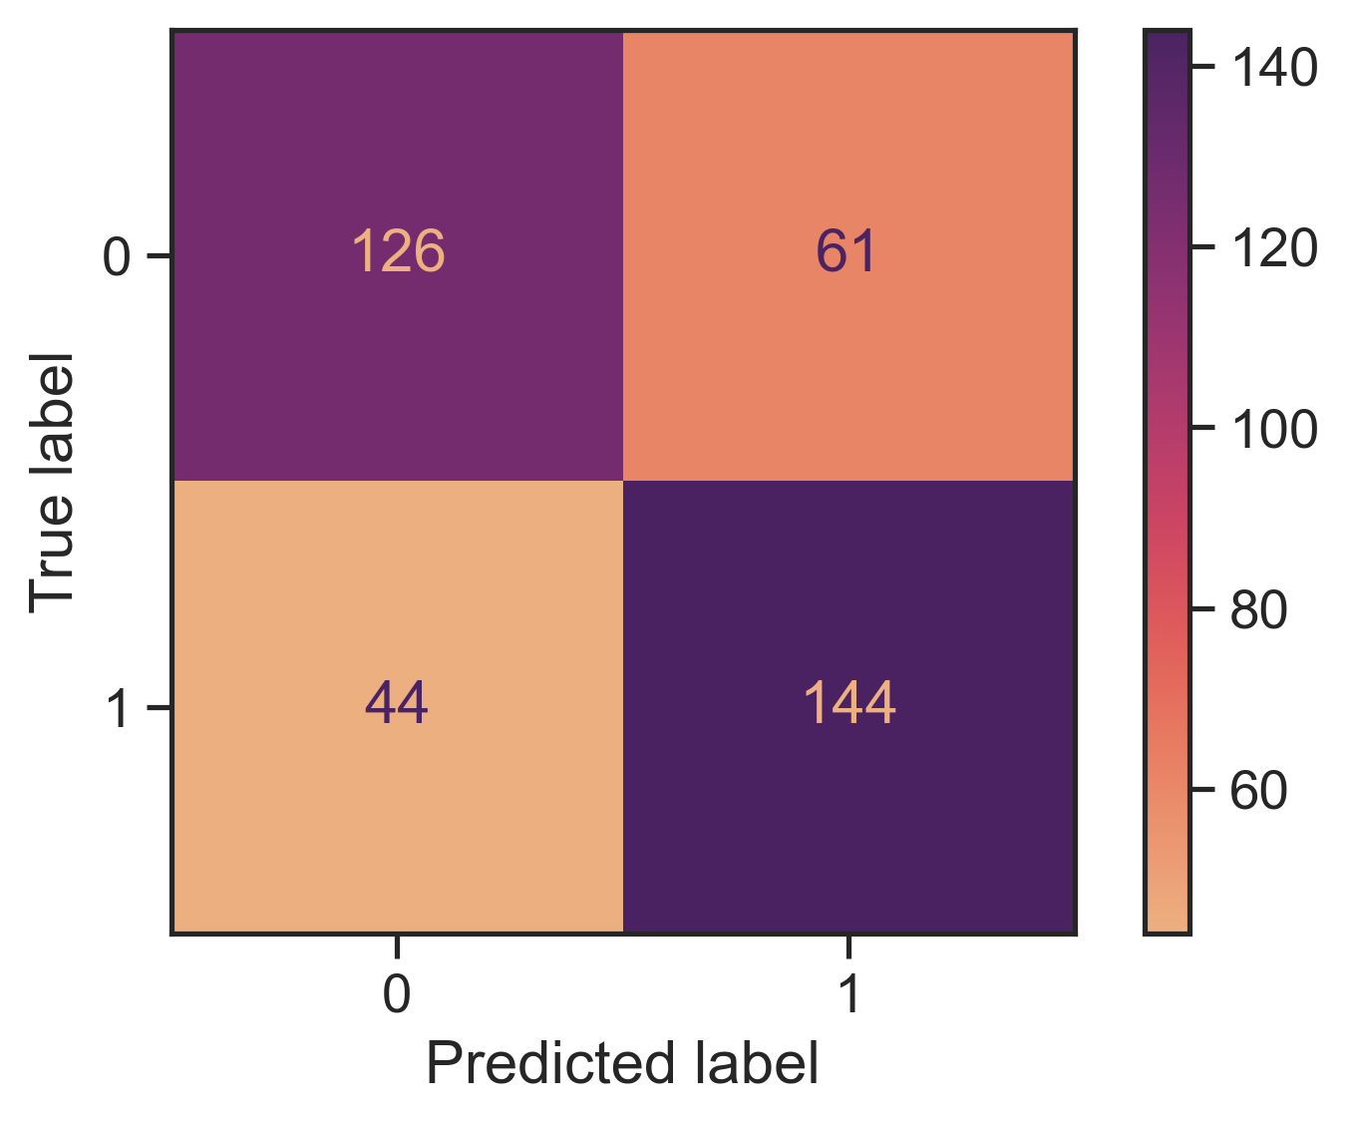
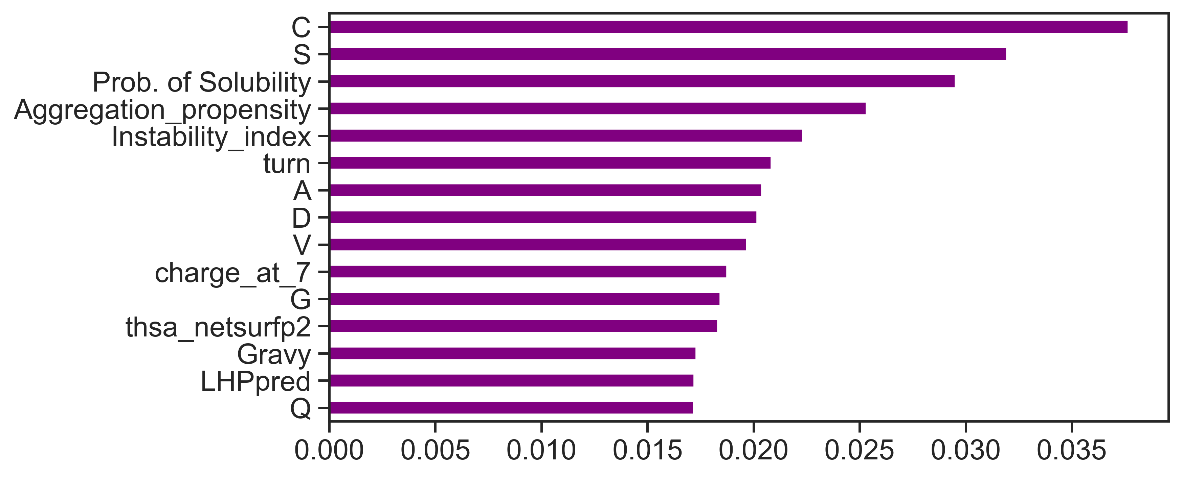
A
B
C

Slide 7
Solubility

Slide 8
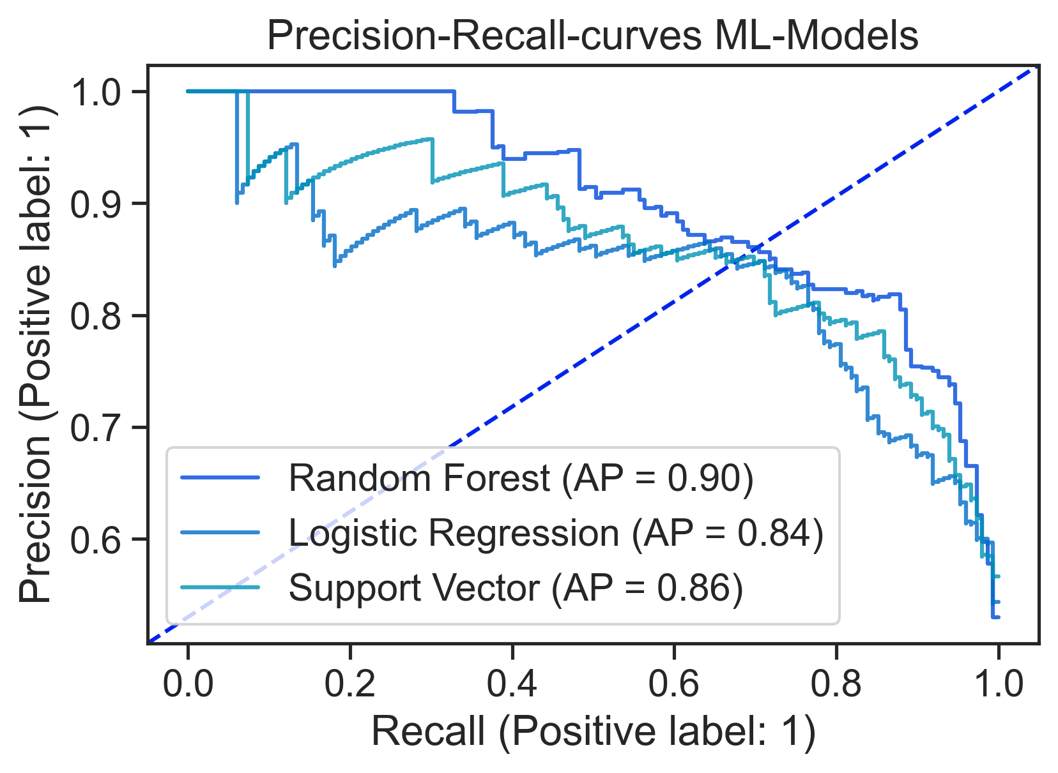
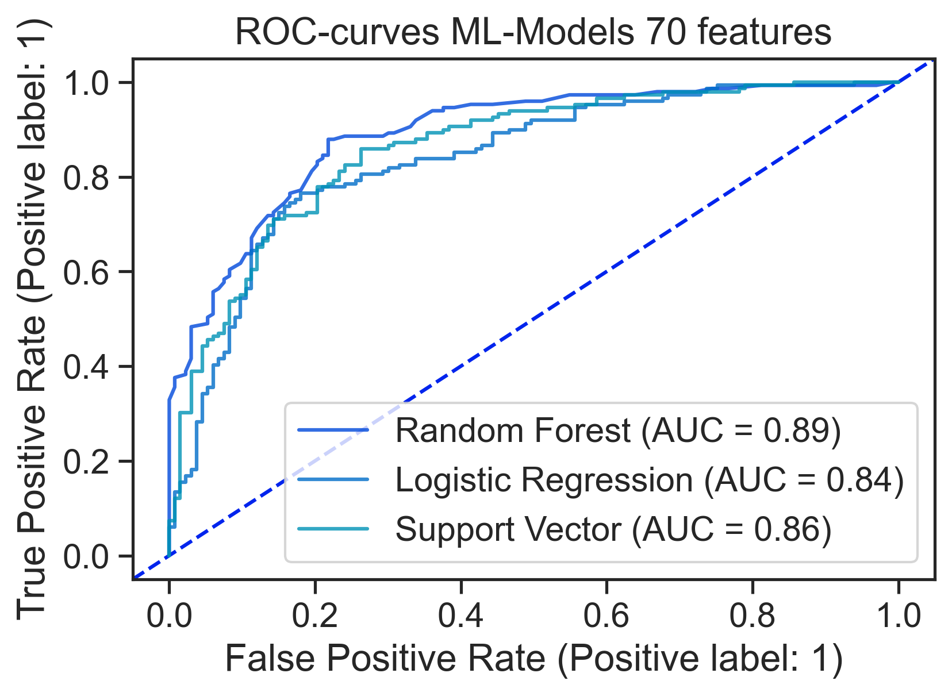
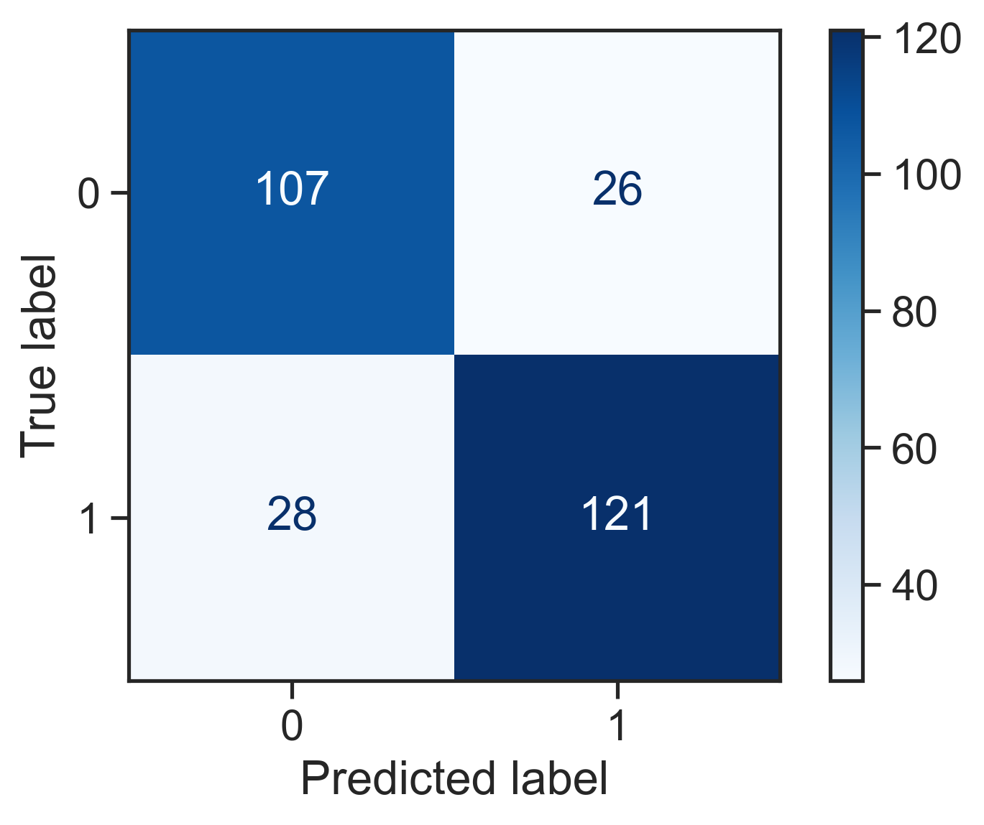
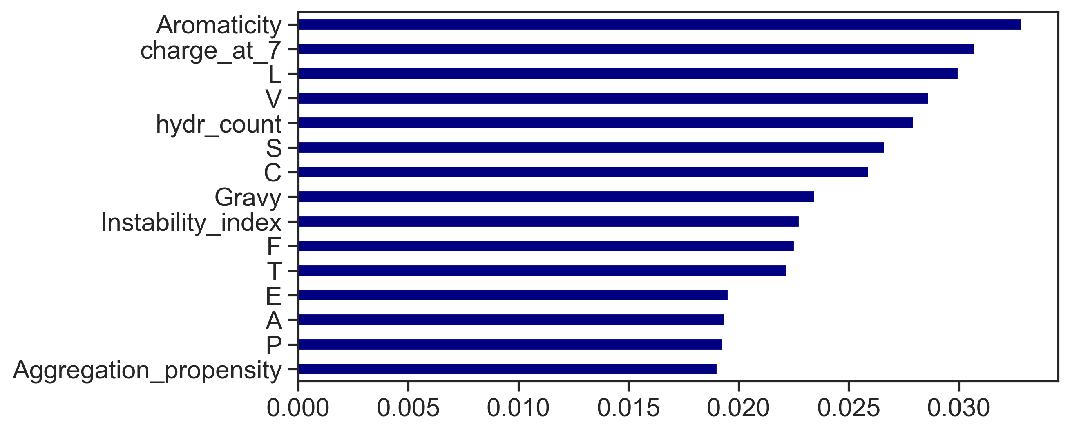
A
B
C
D

Slide 9
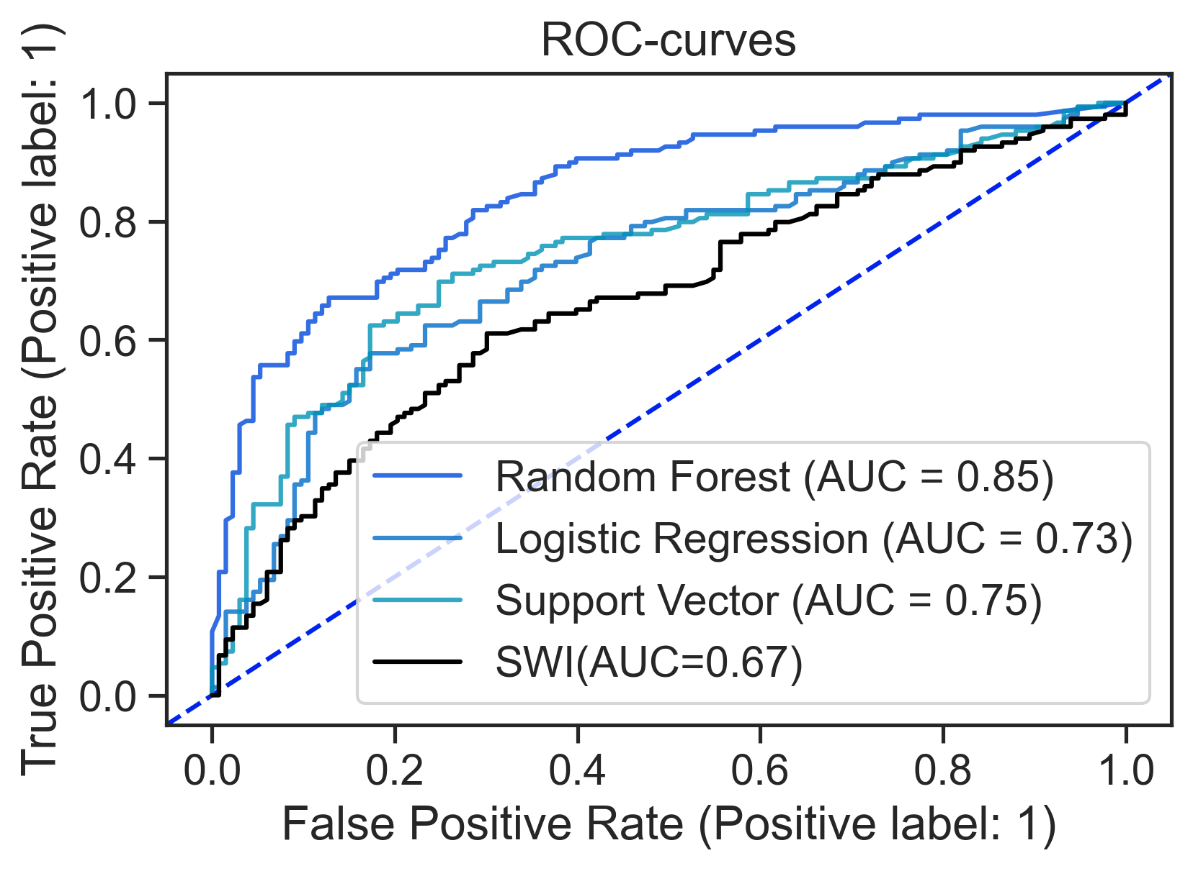
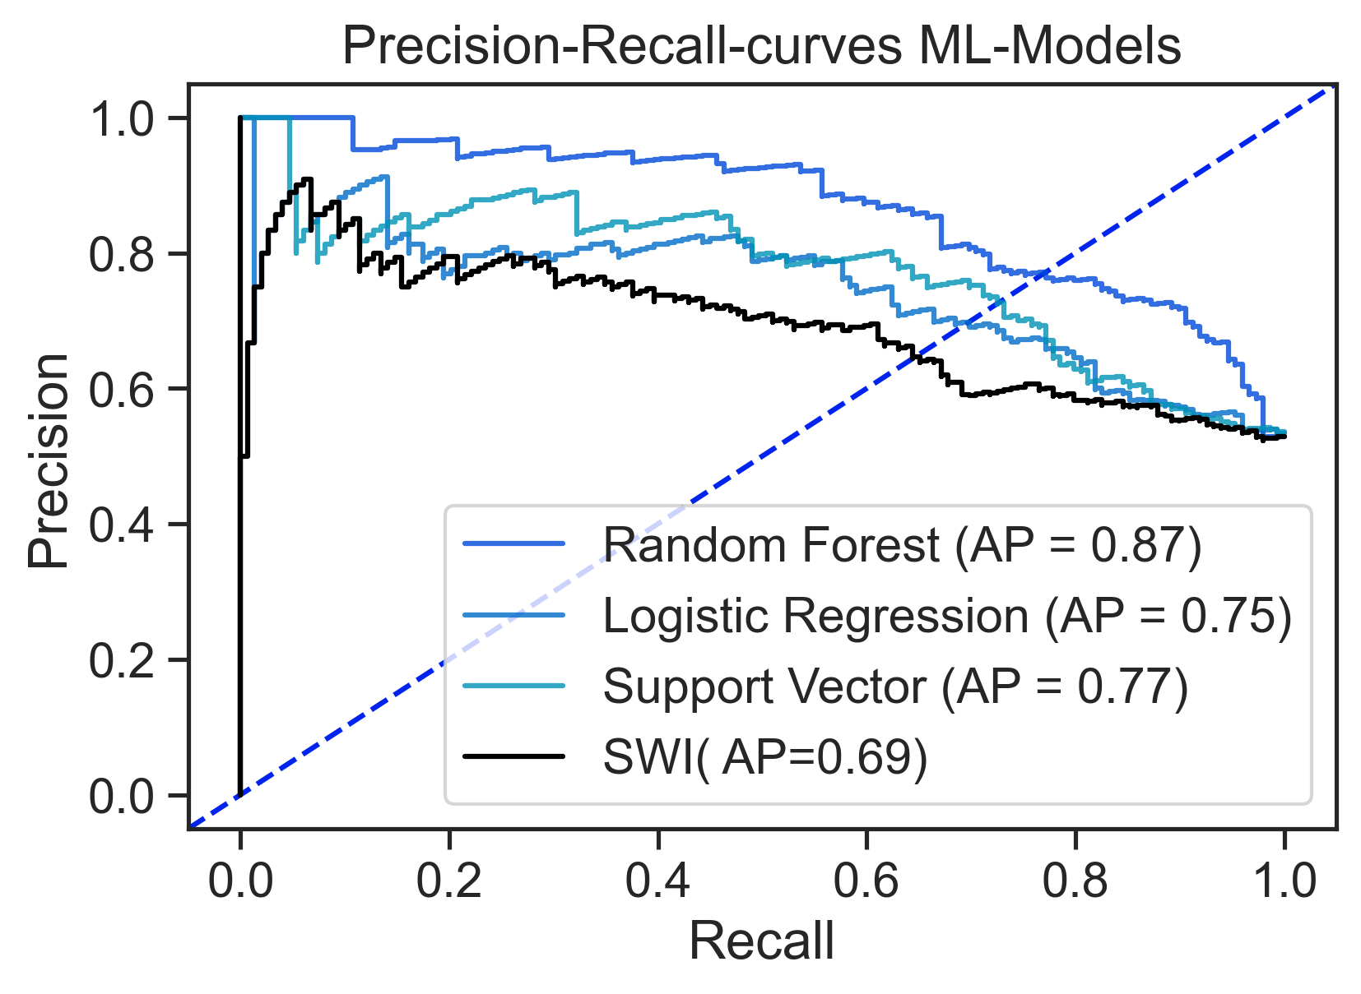
A
B

Slide 10
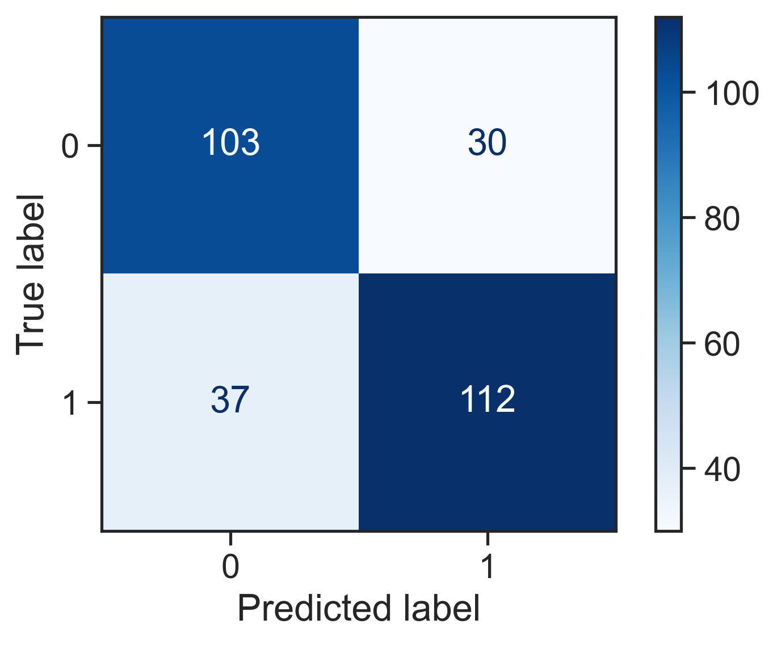
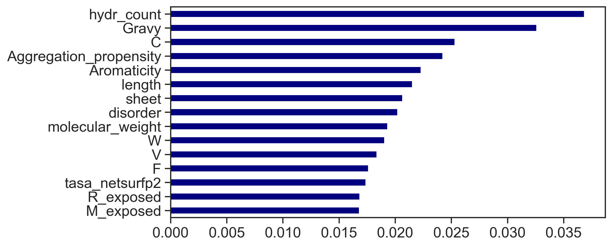
A
B
C

Slide 11
Aggregation

Slide 12
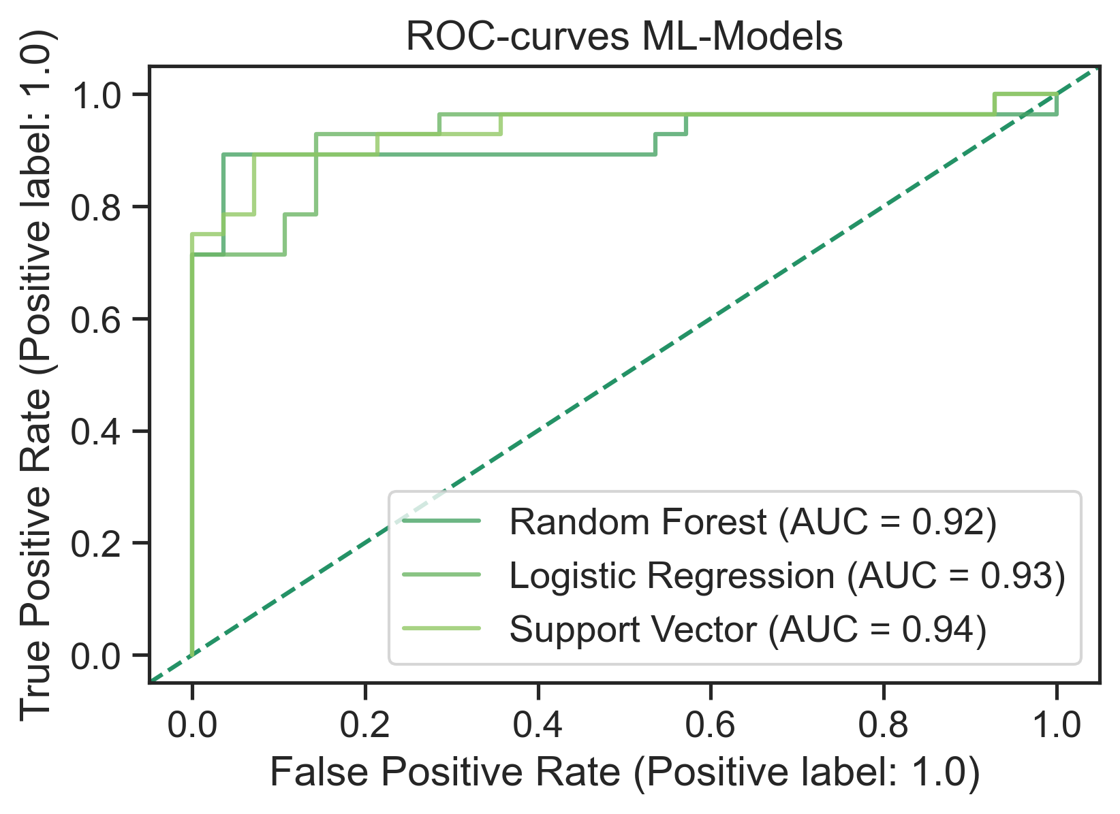
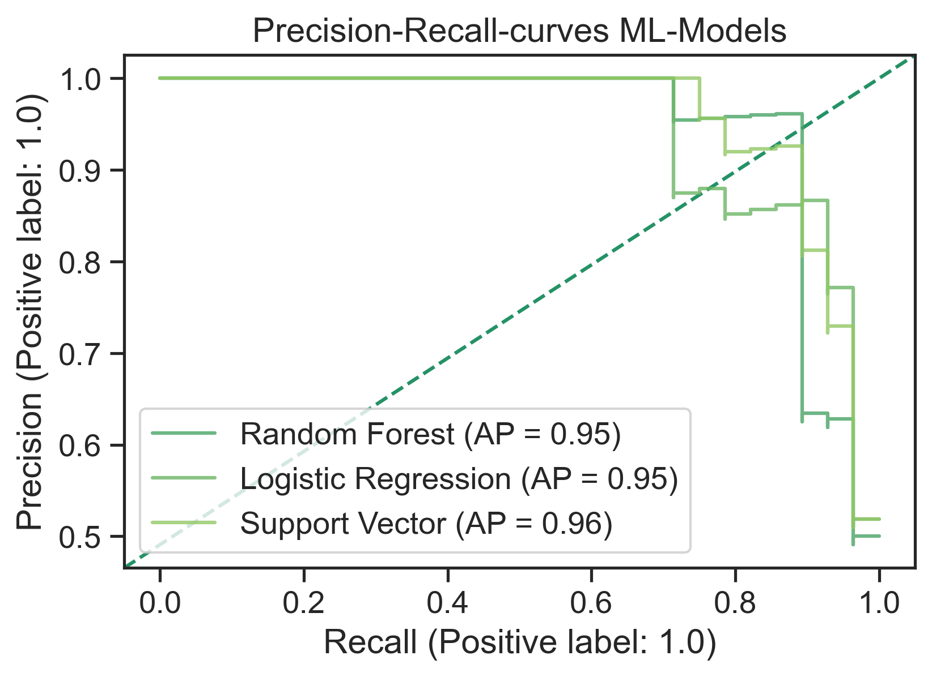
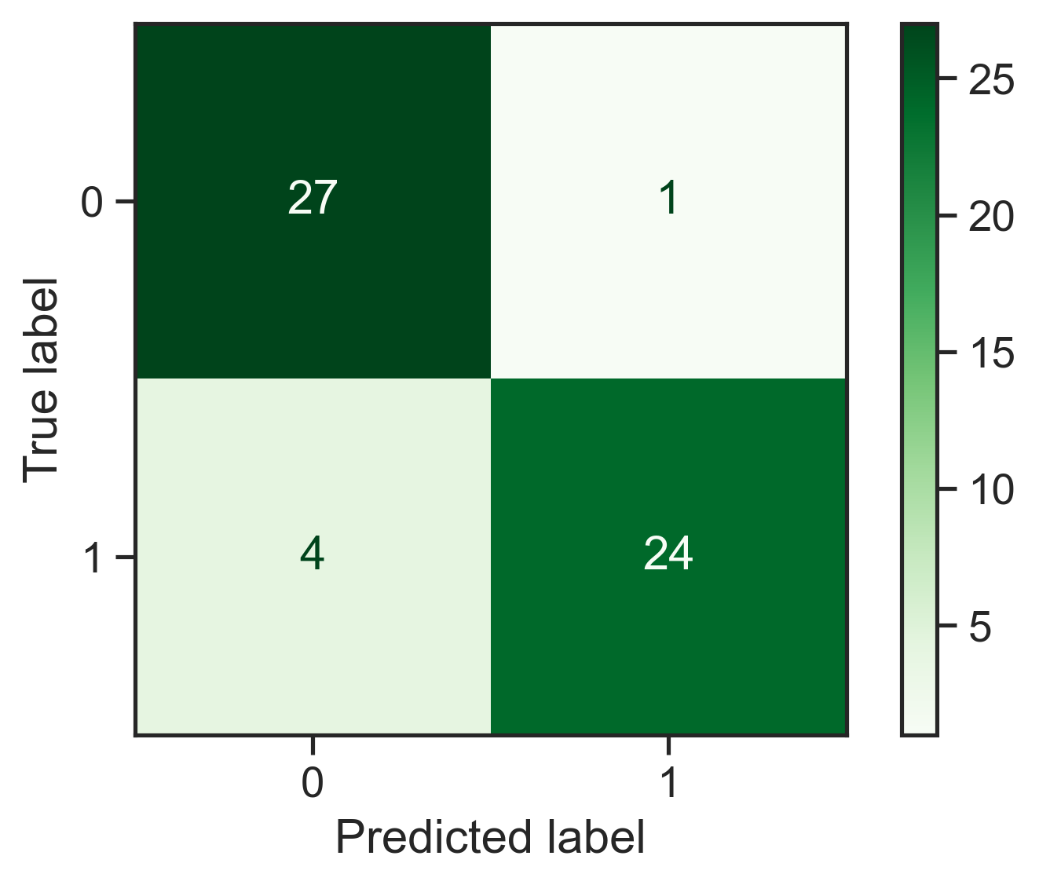
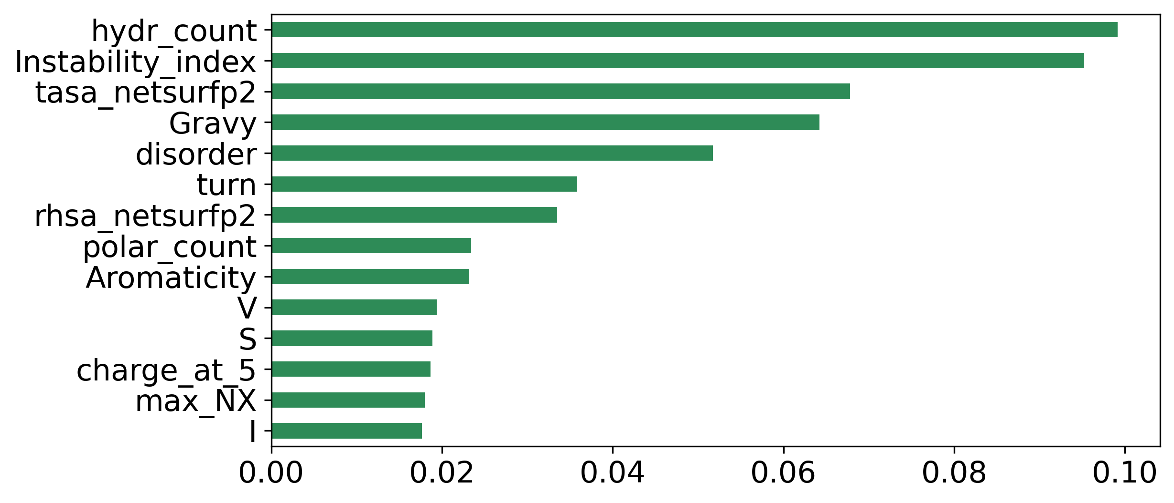
A
B
C
D

Slide 13
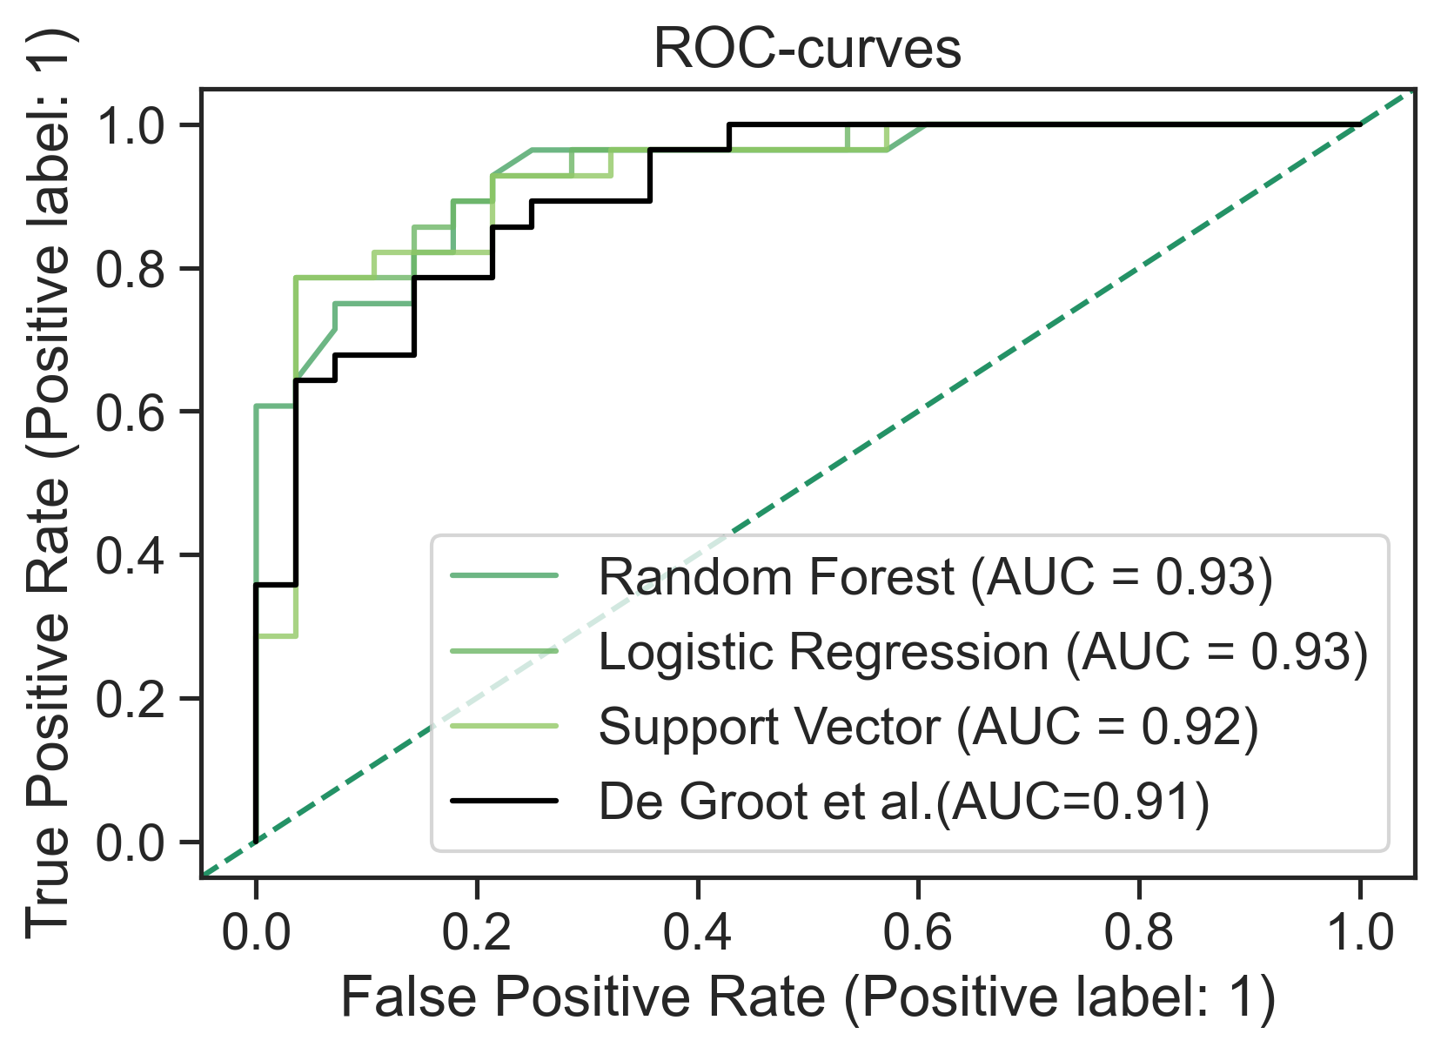
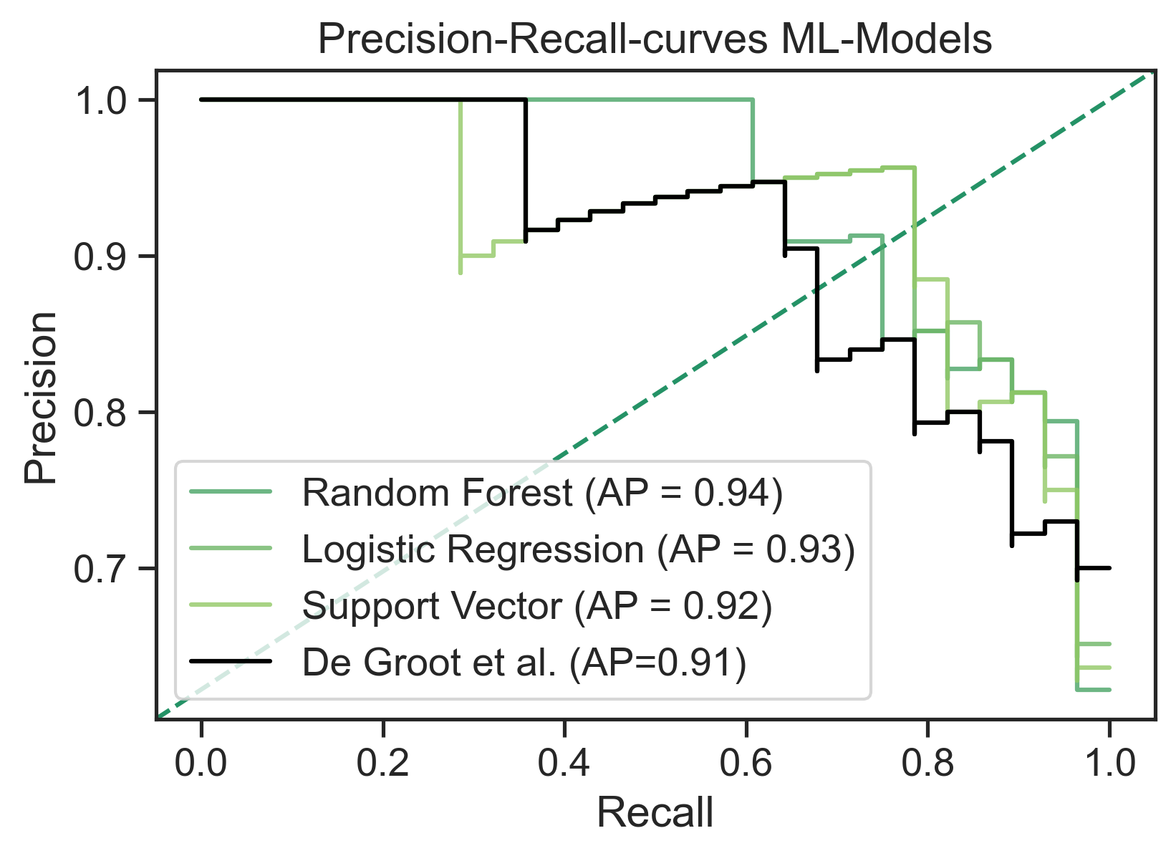
A
B

Slide 14

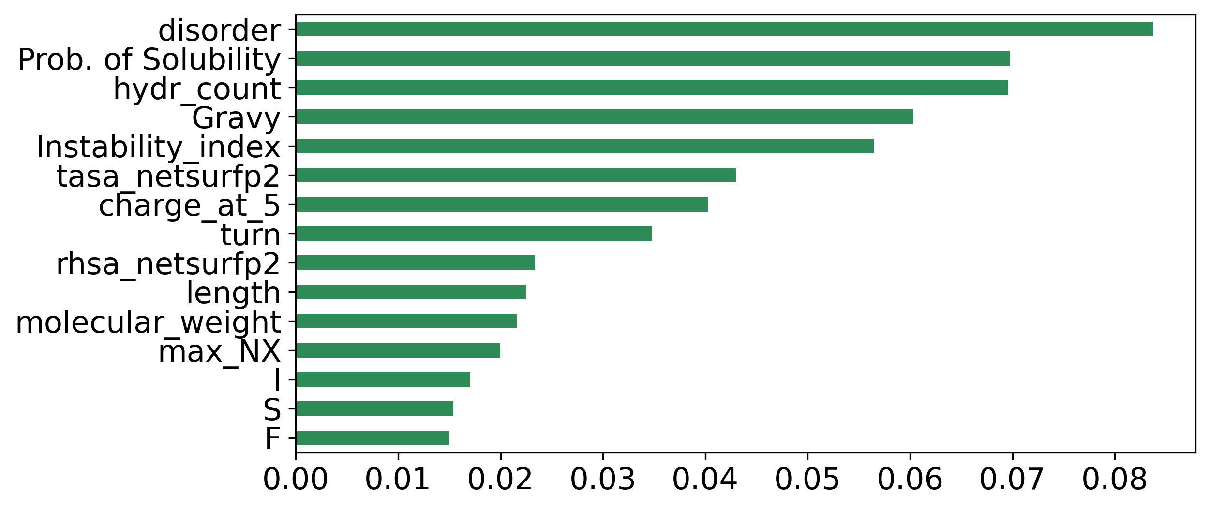
A
B
C

Slide 15
suplementary

Slide 16
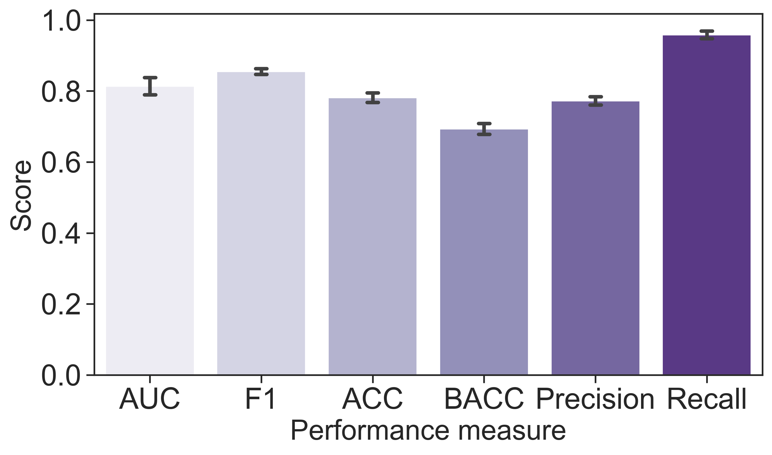
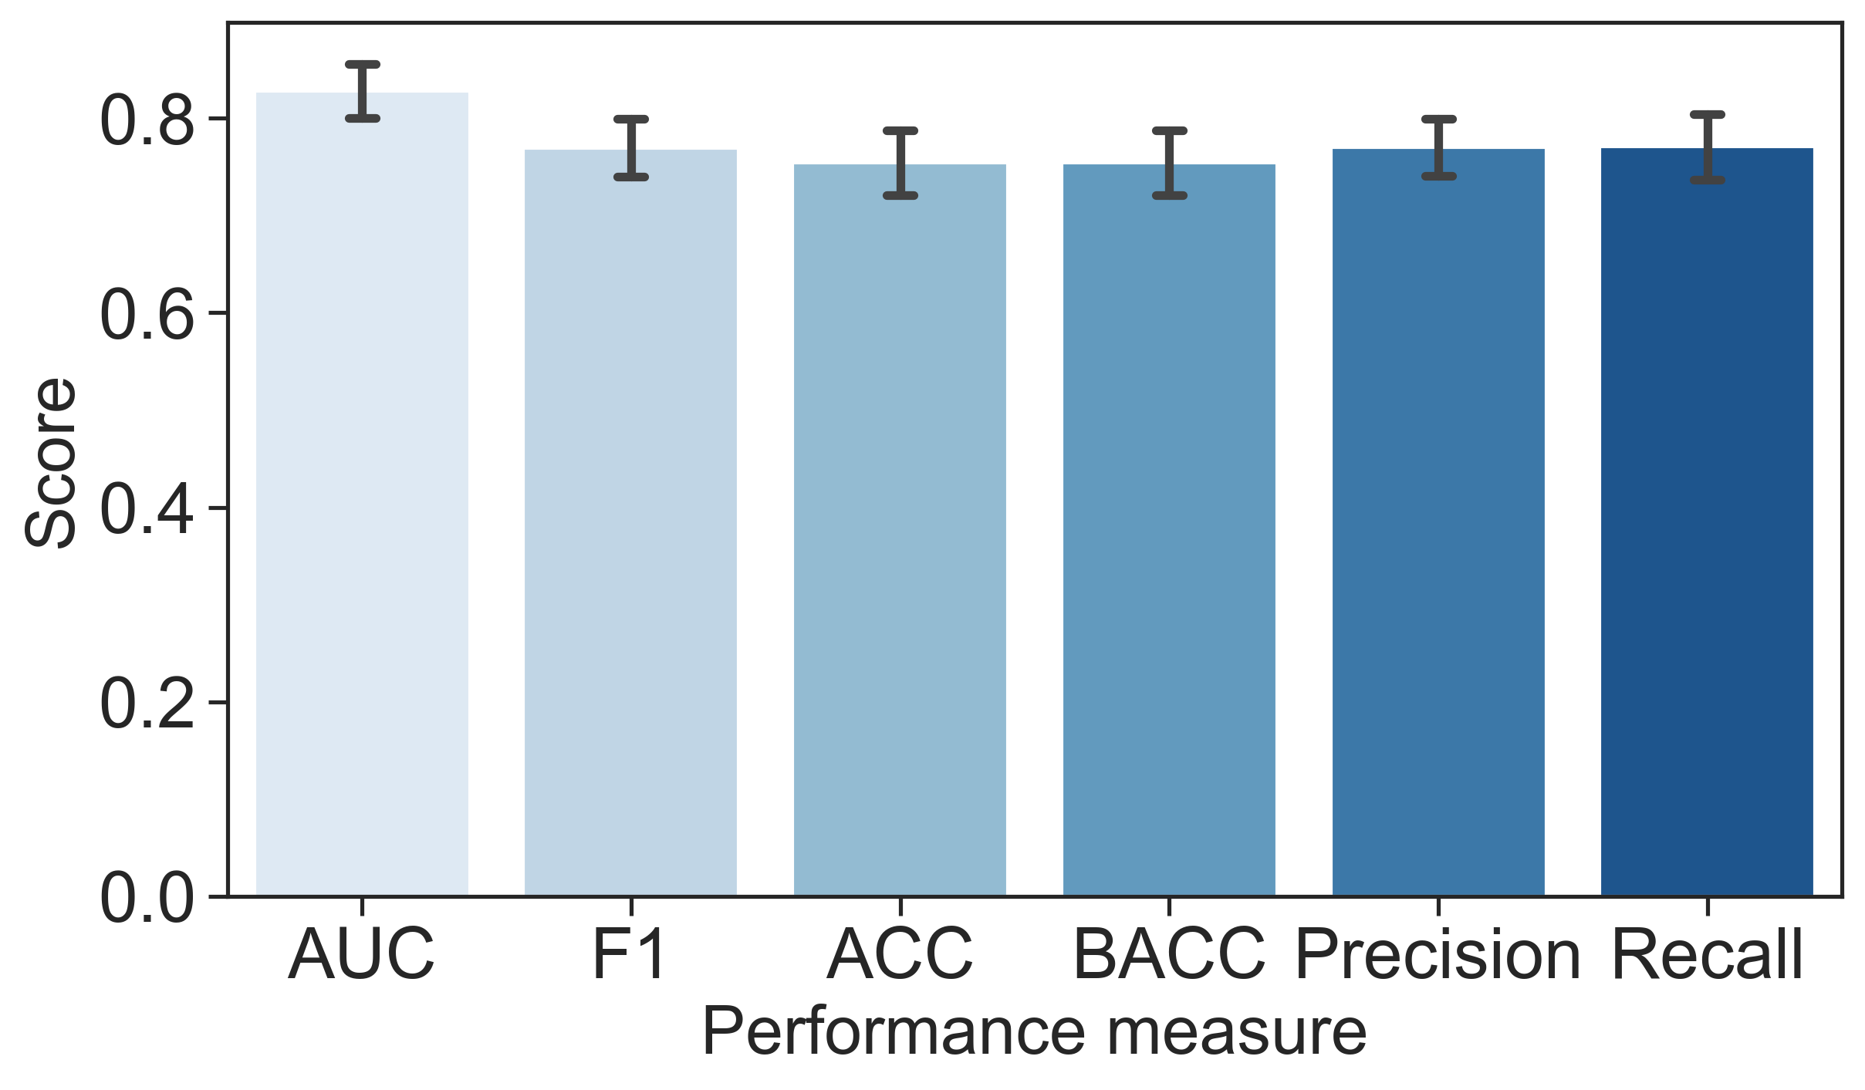
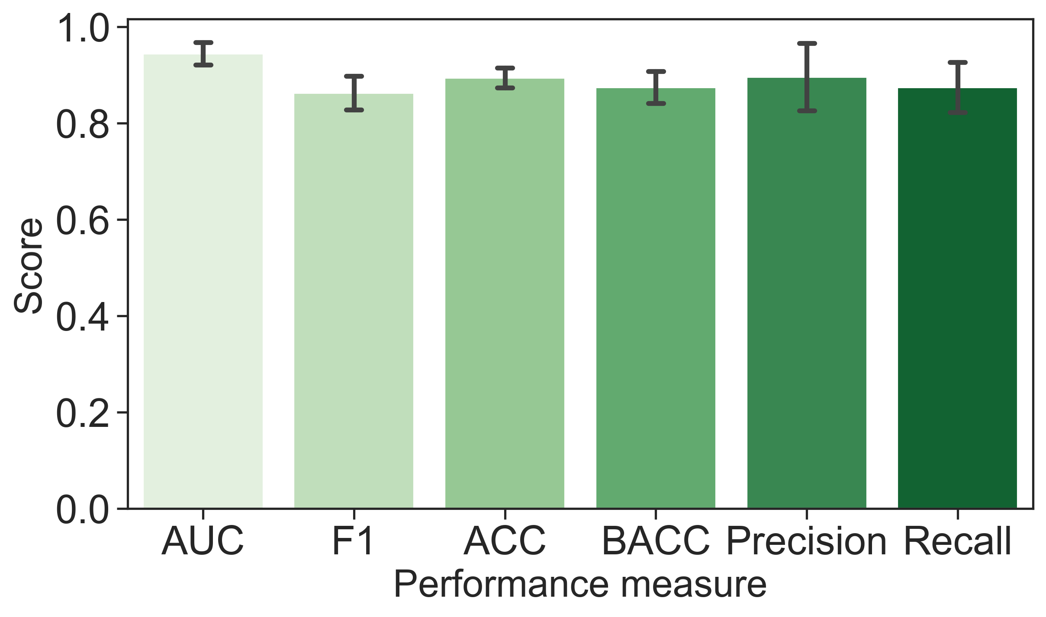
A
B
C

Slide 17
Data Curation
Data Visualisation
Machine Learning
Statistics
Predicting expression
70 features
Models: RF, SVM and LR
ROC-AUC
Feature importance
Gini Importance
RNA Human Expression data
Human Protein Atlas Uhlén, et al. (2015)
Feature significance
Mann Whitney U test
Fishers exact test
Solubility
Predicting Solubility
69 features
Models: RF, SVM and LR
ROC-AUC
Bhandari, et al. (2020)
Aggregation Disaggregation
Predicting Aggregation
69 features
Models: RF, SVM and LR
ROC-AUC
Määttä, et al. (2020)

Slide 18
Aggregation Disaggregation
Solubility
RNA Human Expression data
Määttä, et al. (2020)
Bhandari, et al. (2020)
Human Protein Atlas Uhlén, et al. (2015)

